Slide 1
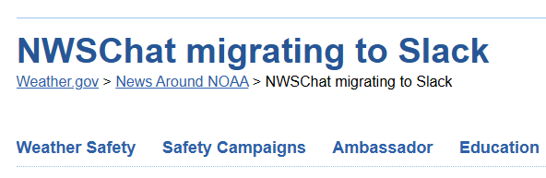
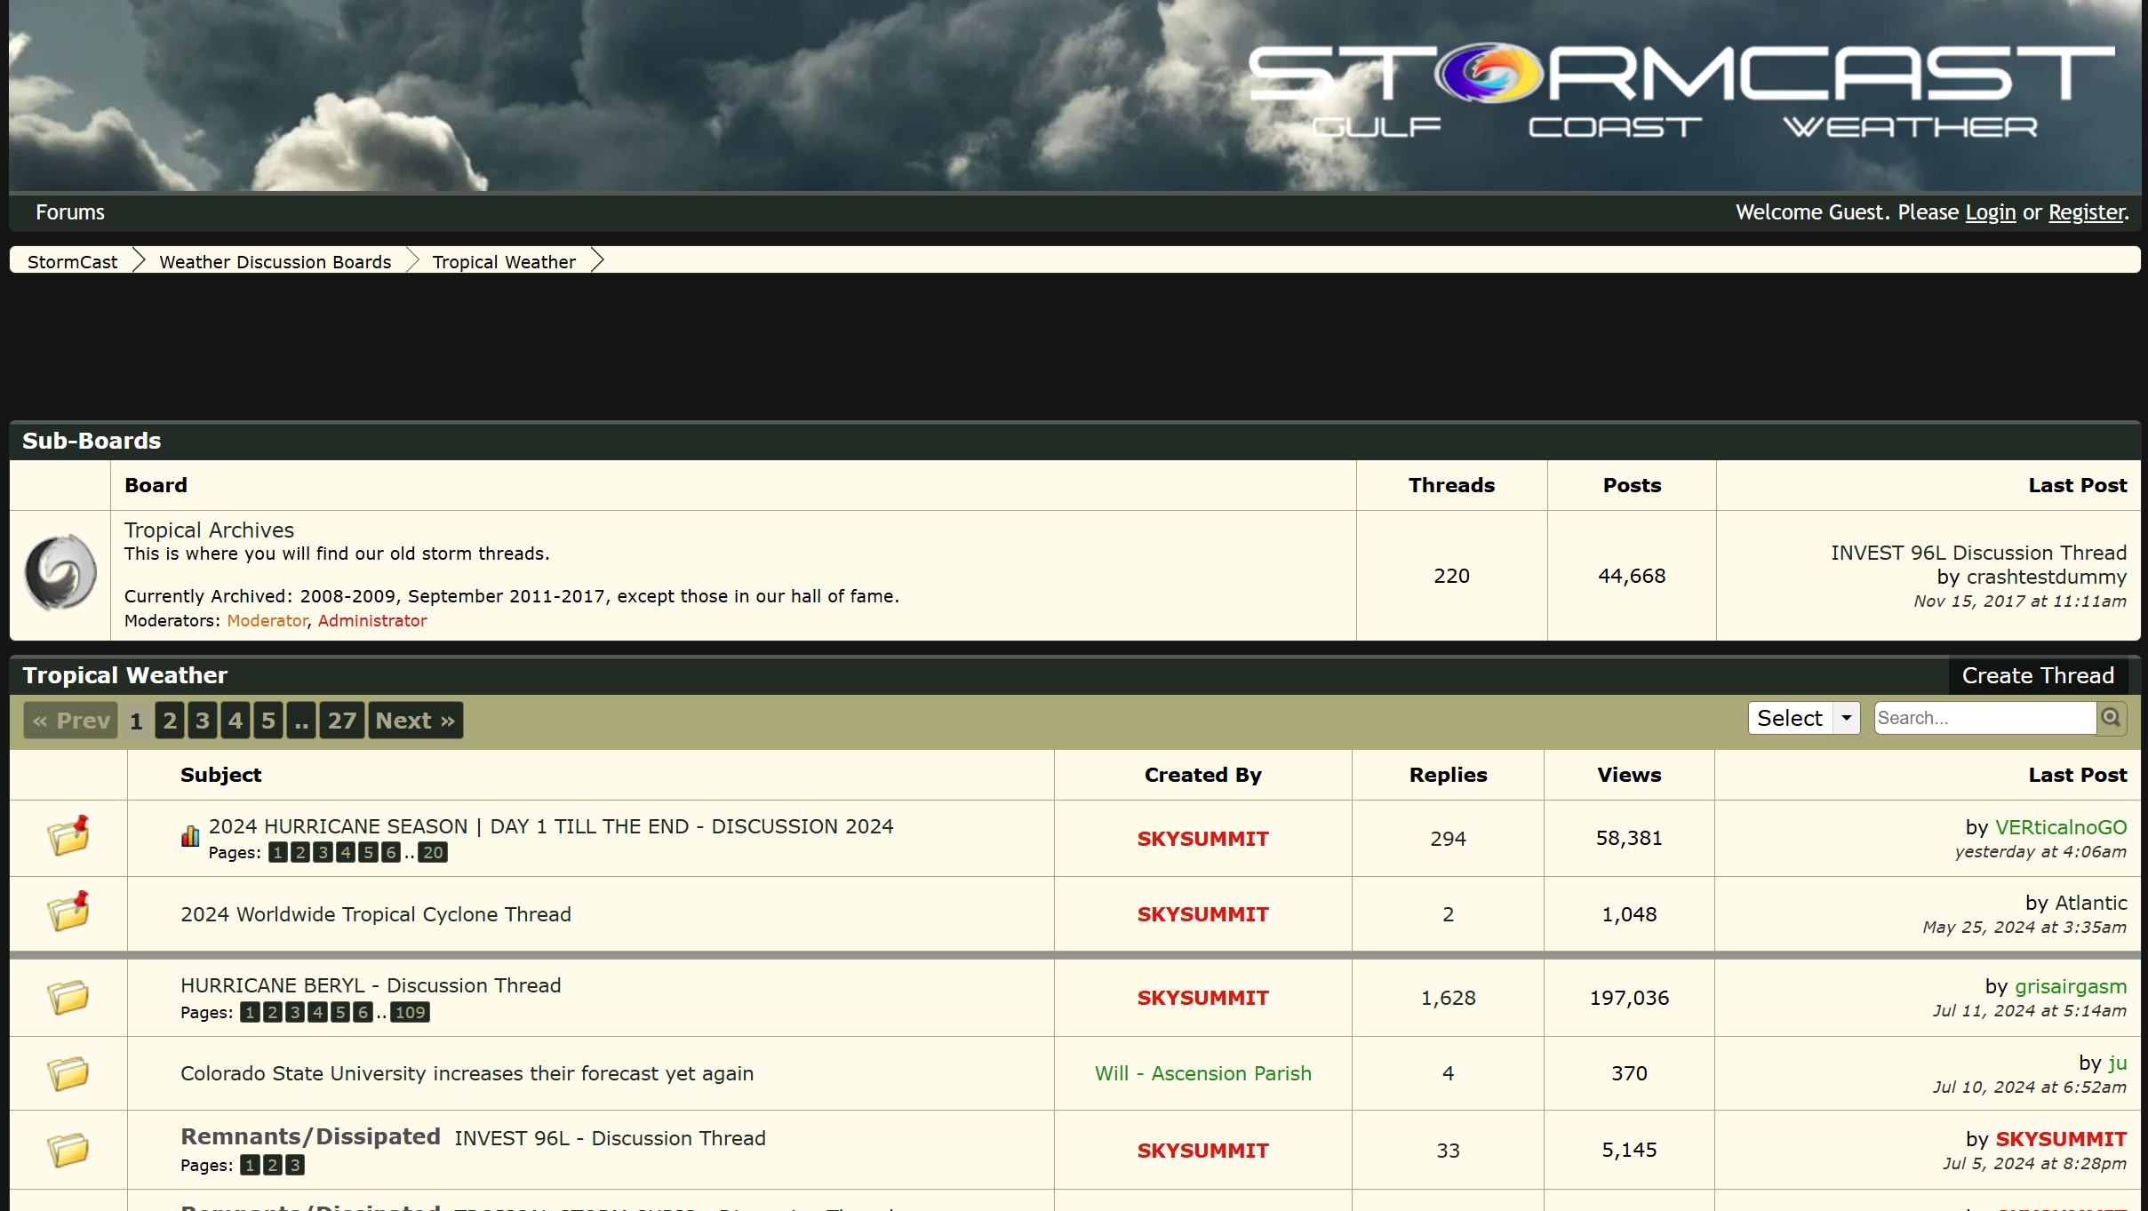
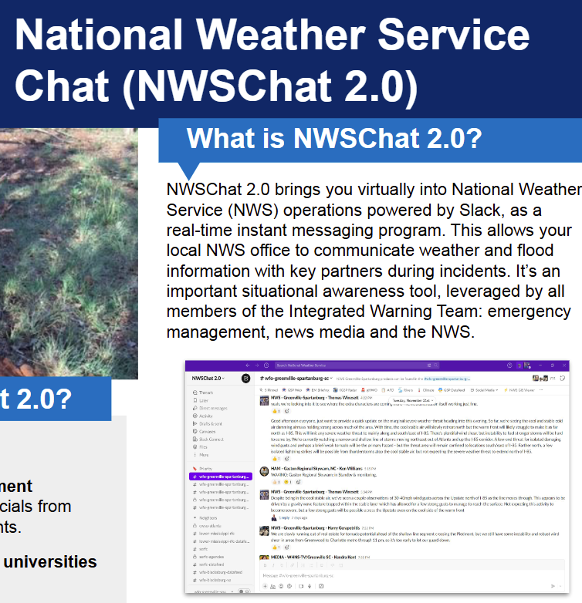
Tech issues - Chatroom
Why we want to build a chatroom? - Real needs & better solutions
NWSChat
STORMCAST
High threshold
Only available to professional weather-relative officials.
Performance requirements
Migrated to Slack - Emergency of improving reliability, security and expand functionality.
“Half-realtime”
The format of the forum makes replies lose timeliness.

Slide 2
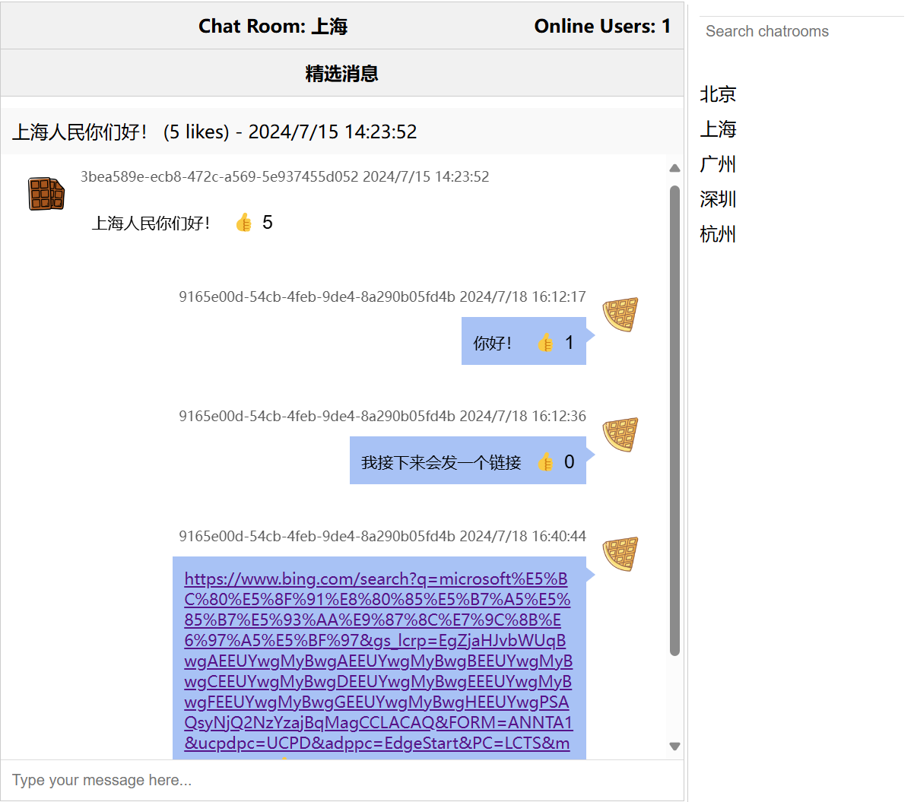
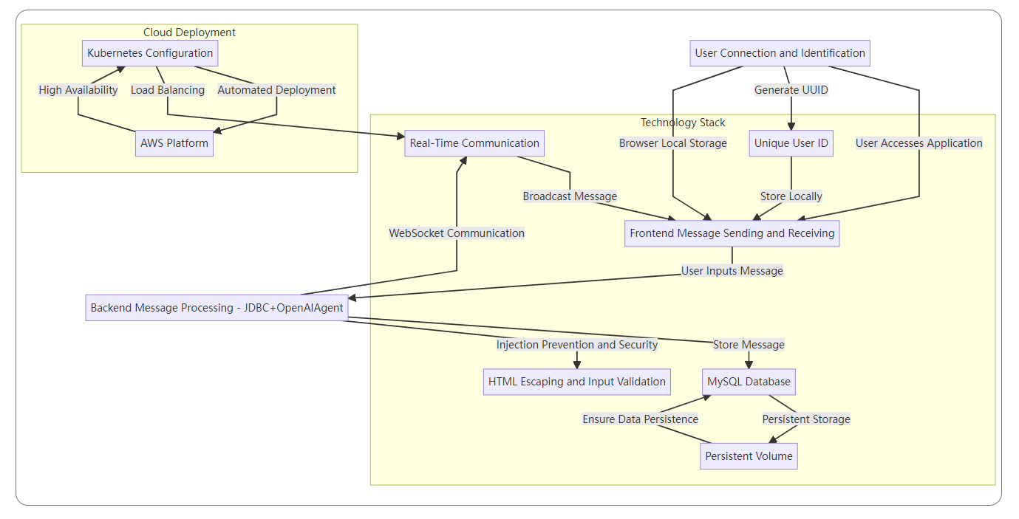
Tech issues
The workflow of chatroom
Backend - Java + spring boot / OpenAI Agent
DB - JDBC + MySQL
Protocol - Websocket

Slide 3
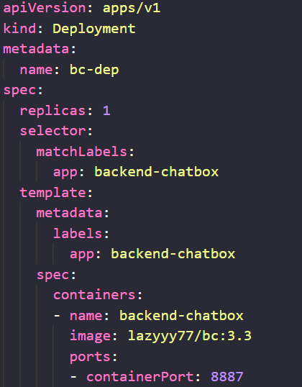
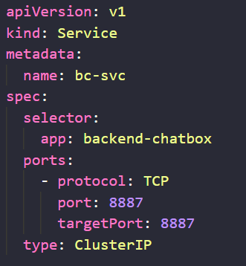
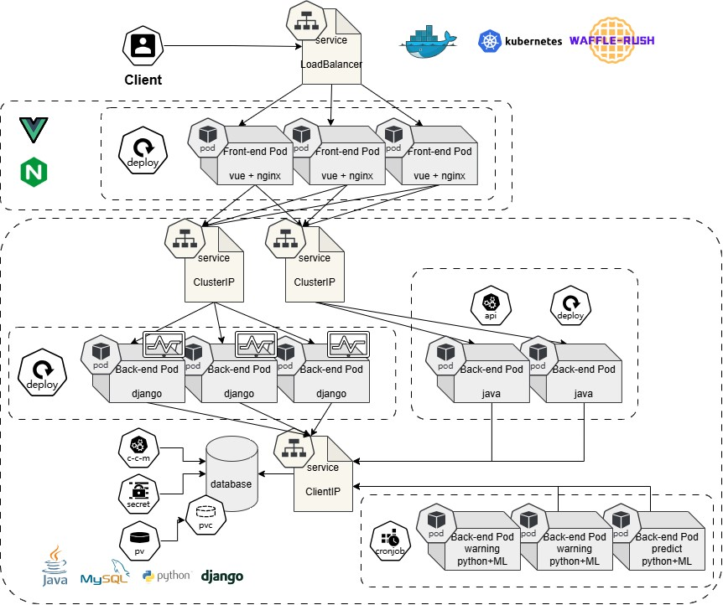
Tech issues
The deployment of chatroom
bcdep.yaml
bcsvc.yaml

Slide 4
Tech issues
How it ftis the cloud environment
Elastic Expansion:
Automatically scales resources based on load, preventing performance bottlenecks during user surges.
High Availability:
Ensures system reliability through multi-copy deployment and load balancing, maintaining normal operation even if nodes fail.
Convenient Management:
Simplifies application deployment, monitoring, and maintenance with automated Kubernetes functions.

